Slide 1

Internship Presentation
CRUZ, MALLARI, VALENA

Slide 2
What have we done?

Slide 3


Slide 4
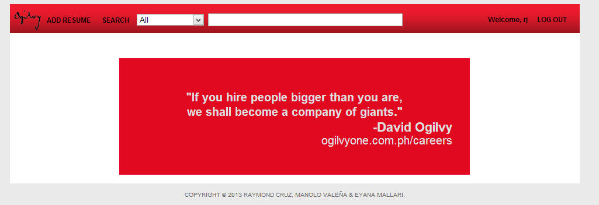

Slide 5


Slide 6


Slide 7
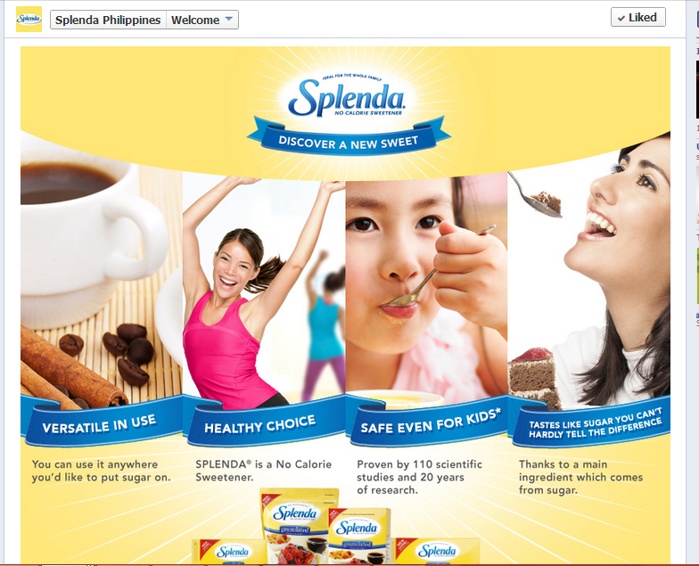


Slide 8


Slide 9
What have we Learned

Slide 10


Slide 11


Slide 12


Slide 13

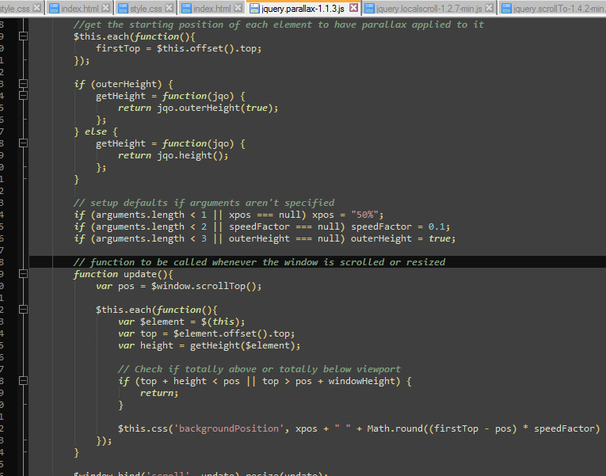




Slide 14

